Slide 1
How To API With Silex
Joey Rivera
Notes:
question:
How many use Silex, APIgility, Slim

Slide 2
Me!
Joey Rivera @joeyrivera
Hobbies
Family Life
Php
AngularJS
Cars
Gamer
Work at Salesforce Pardot

Slide 3
What is it?
Micro-framework
Built on symfony
Great for API
EASY!

Slide 4
Features
Pimple
Routing
GET/PUT/POST/DELETE/PATCH/OPTIONS
Middlewares
Before/after/finish
ServiceProviders
Twig/security/monolog/doctrine
Controllers
Commands

Slide 5
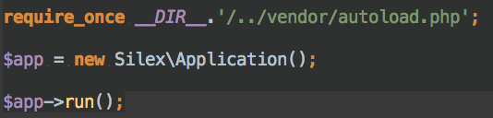
Setup
Composer
"silex/silex": "~1.3”
Rewrite rules/.htaccess
Note: $app becomes the DIC

Slide 6
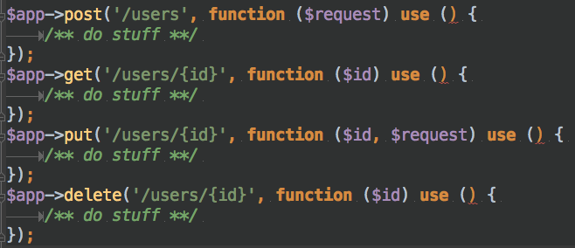
HTTP Methods
GET/PUT/POST/DELETE/PATCH/OPTIONS

Slide 7
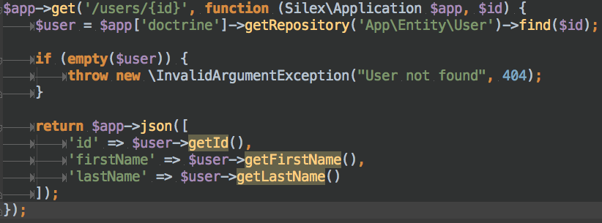
HTTP Methods Cont.
Real example getting a user:
GET /users/1

Slide 8

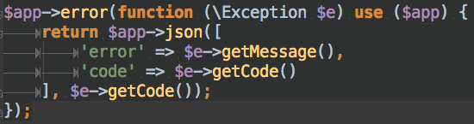
Middleware and Error Handling
Authentication
Error Handling

Slide 9
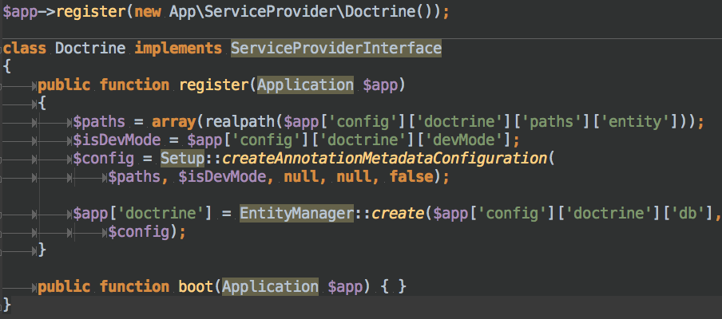
ServiceProvider
DoctrineORM Exaple

Slide 10
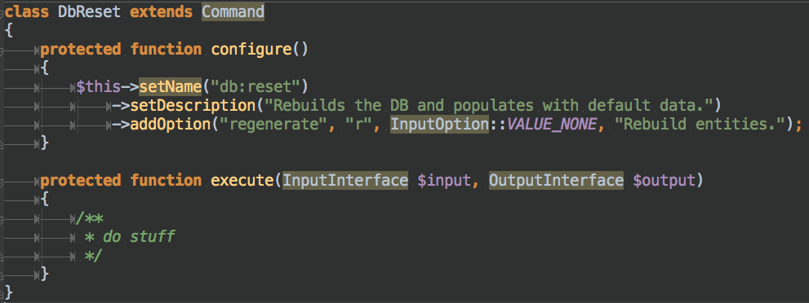
Commands
DbReset Example

Slide 11
Live Example!

Slide 12
Question?
@joeyrivera
All code at:
https://github.com/joeyrivera/phpug-silex-intro
http://silex.sensiolabs.org/

